Slide 1
AS Computing
COMP2 - Functional Characteristics of a Processor

Slide 2
RAM
The program currently being executed and the data used by the program are held in memory.
RAM is divided into millions of individually addressable storage units called bytes. Each location has it’s our unique identifying numerical code.
A byte can hold one computer character, or part of a sound, image or program instruction.

Slide 3
Stored Program Concept
This is the concept of a machine which executes instructions.
The instructions are held in memory and then fetched individually by a processor, which first decodes the instruction and then executes it.

Slide 4
Background to the Fetch-Execute Cycle
Instructions CANNOT be executed in backing storage (e.g. on the hard disk).
They MUST be loaded into main memory (RAM) first.
Each instruction and required items of data can now be fetched serially ONE by ONE into the registers of the processor and executed by the processor (i.e. carried out).

Slide 5
The Processor Components
Program Control Unit
  This fetches program instructions from memory decodes them and then executes them one at a time.
ALU
  Arithmetic and Logic Unit carries out the arithmetic and Boolean operations needed during program execution.

Slide 6
The Processor Components
Registers
  These are fast storage locations within the CPU. They are either General Purpose or Dedicated Registers.
Internal Clock
  This is used to co-ordinate the activities of the processor by generating a continuous sequence of pulses to step the control unit through its operation. The faster the clock speed the faster a computer will execute instructions.

Slide 7
Dedicated Registers
CIR (Dedicated Register)
  Current Instruction Register – This hold the current register which is being decoded and executes, e.g. LDA 1000.
Program Counter
  This is a dedicated register which always points to the next instruction in RAM, during program execution.

Slide 8
Dedicated Registers
Accumulator
  This holds the result of the current calculation.
Memory Address Register (MAR)
  This holds the address of the memory location currently being accessed by the processor.
Memory Buffer Register (MBR)
  This hold the data being transferred to or from the memory location currently being accessed.

Slide 9
Dedicated Registers
Status Register
  This holds the codes that indicate the outcome of an operation. E.g. is the result positive, negative or zero, or has overflow occurred.
Stack Pointer
  Points to a stack holding return addresses, sub-program parameters and local variables. This basically allows the path of execution to be tracked correctly.

Slide 10
The Processor Contents
General Purpose Registers
  These are used for performing arithmetic functions; they hold the values being operated on or the result of an arithmetic operation. In some computers only one general purpose register is available, usually called an accumulator. The can be used very quickly.

Slide 11
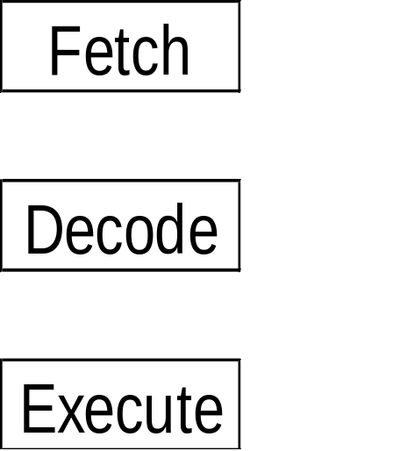
What is the Fetch-Execute Cycle ?
Fetch-Execute Cycle is the name gain to the method used to execute the individual instructions that make up a computer program.
Control Unit Program Counter, Registers, and the ALU (Arithmetic and Logic Unit ) are all used in this process.
Notes:
Execute means the computer carrying out an instruction
The processor (CPU) consists of 3 main components:
The Arithmetic-Logic Unit (ALU) in which all arithmetic and logical operations are carried out
The Control Unit co-ordinates the activities within the CPU, and sends control signals to memory and peripherals
The System Clock generates a continuous sequence of clock pulses to step the control unit through its operation

Slide 12
The Fetch Stage
Fetch Stage
  There are two parts to this stage:
  The first stage is to get the NEXT instruction from main store. The address of the next instruction to be obeyed is stored in the program counter.
  The second stage is to RESET the Program Counter (PC) so that it always contains the address of the NEXT instruction to be fetched.

Slide 13
Decode (Instruction) Stage
Decode Stage
  However the Control Unit does not yet know what data to act upon, so between the fetch and execute stages the Control Unit examines and decodes the instruction in the Current Instruction Register (CIR) to determine the type of instruction, e.g. ADD, JUMP.
  It also brings the necessary data for the instruction to act upon from main memory and stores them in the appropriate registers.
    e.g. ADD num1, num2
    e.g. JUMP linenum1
Notes:
Registers - are areas of the processor used to very briefly place instructions that need to be decoded or data that needs to be immediately manipulated e.g. Data, Current Instruction and Memory Data registers.

Slide 14
Execute (Instruction) Stage
Execute Stage
  The Control Unit and/or the ALU carries out the instruction as stored in the Current Instruction Register using the data stored in the appropriate registers
  The cycle now begins AGAIN !

Slide 15
Performance – Word Size
Word Size
  This refers to the number of bits that a CPU can process simultaneously. Bits may be grouped into 8, 16, 32, 64 or 128-bit ‘words’. Thus 32-bit word machine can deal with 32 bit instructions at a time. The larger the ‘word size’ the faster the machine will operate.
  Think of a supermarket – the more tills that are available, the more customers can be processed per hour.

Slide 16
Performance – Bus Width
Bus Width
  This refers to the number of bits that can be simultaneously transported on each of the computers buses. The larger the bus width the faster the computer will operate. Bus width tend to be either 8, 16, 32, 64 or 128-bit.

